Slide 1
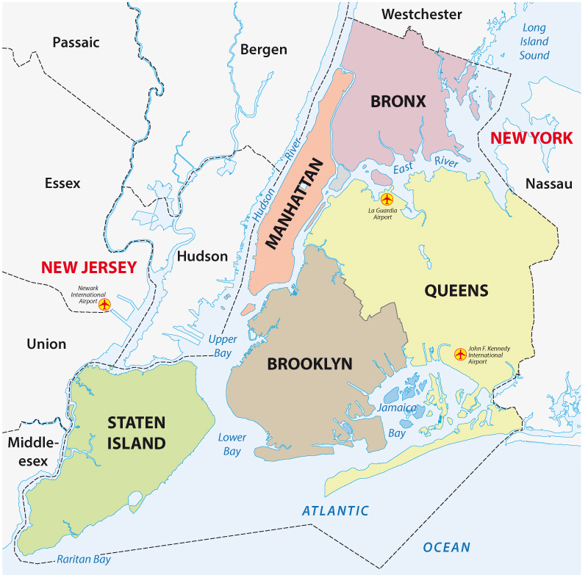
Find the Best borough location to Open an Indian Cuisine Restaurant in New York Area
Capstone Project - The Battle of Neighborhoods

Slide 2
Background
There are about 2.7 million Indians in the U.S. -- about half a million in New York City.
Business decision makers need to consider different factors in finding the right location for the business, such as financial factors, market factors, and the factors that will affect their demand and revenue.
This project can help those who are planning to open a new Indian cuisine restaurant in New York area.

Slide 3
Business Problem
To find the best borough in New York City to open an Indian Cuisine Restaurant. A suitable neighborhood which is close enough to some amenities and venues and has fewer competitors.
An ideal location should be one where there is highest concentration of Indian Americans in New York.
To extract the information such as which borough has the lowest number of restaurants per Indian American population, so that new venture would have minimum competition and maximum market potential.

Slide 4
Data
The elaborative New York City data containing the neighborhoods and boroughs, latitudes, and longitudes has been obtained from the data source:
https://cocl.us/new_york_dataset.
To get authorized information about demography of the New York boroughs the US census bureau data from the Wikipedia page
https://en.wikipedia.org/wiki/Indians_in_the_New_York_City_metropolitan_region
Sent to approximately 295,000 addresses monthly (or 3.5 million per year), it is the largest household survey that the Census Bureau administers. Sent to approximately 295,000 addresses monthly (or 3.5 million per year), it is the largest household survey that the Census Bureau administers.
All data related to locations and quality of Indian restaurants will be obtained via the Foursquare API utilized via the Request library in Python.

Slide 5
Target Audience
Business personnel who wants to invest or open an Indian restaurant in NY. This analysis will be a guide to start Indian restaurants targeting the Indian Americans.
Freelancer who loves to have their own restaurant as a side business.
Indian origin person who wants to move in the neighborhoods with lots of option for Indian restaurants in NY.

Slide 6
Methodology
The required data related to New York borough and neighborhood has been collected from https://cocl.us/new_york_dataset and then it was cleaned and processed into a data frame.
Wikipedia webpage containing data regarding the New York Demographics has been scraped using urllib and BeautifulSoup libraries.
Foursquare API has been used to locate all venues and then filtered by Indian restaurants. Ratings, tips, and likes by users will be counted and added to the data frame.
The restaurant Likes and Tips data has been sorted based on rankings
Finally, the data be will be visually assessed using graphing from various Python libraries.

Slide 7
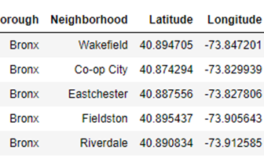
Analysis
A data frame is created with Borough, Neighborhood, Latitude and Longitude details of the New York City’s neighborhood.
Upon analysis, it is found that the data frame consists of 5 boroughs and 306 neighborhoods.
Further, ‘geopy’ library is used to get the latitude and longitude values of New York City, which was returned to be Latitude: 40.71, Longitude: -74.01.

Slide 8
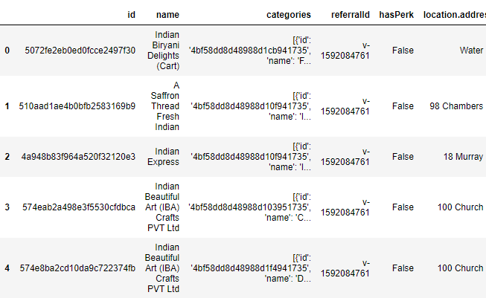
Foursquare API
The Foursquare API is used to explore the neighborhoods for search query “Indian Restaurants”. To access the API, ‘CLIENT_ID’, ‘CLIENT_SECRET’ and ‘VERSION’ is defined.
As a result, a data frame is created with all the Indian restaurants in New York City registered in Foursquare with their Foursquare Id, Name, Category, Latitude and Longitude details.

Slide 9
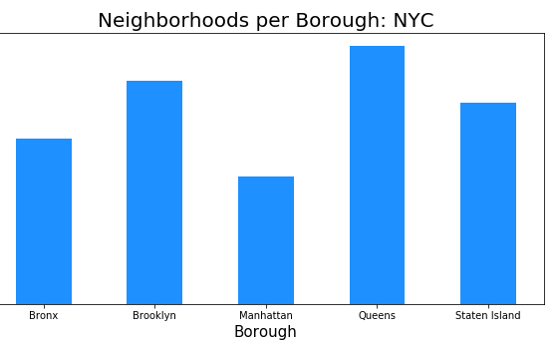
Neighborhoods per boroughs
Using Matplotlib a bar graph that shows Neighborhoods per boroughs in New York is plotted
From the graph we can gather that there are maximum number of neighborhoods in Queens borough.

Slide 10
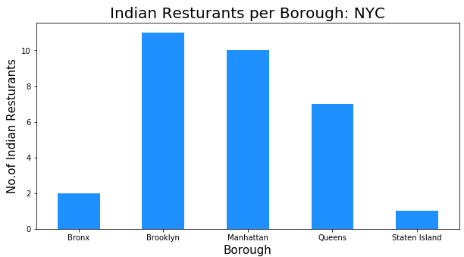
Indian Restaurants per borough
We know that there are maximum number of neighborhoods in Queens borough.
And from the analysis we also know that the best rated restaurant is situated in Staten Island and not in Queens.
So, using matplotlib restaurants per borough has been plotted.

Slide 11
Hypothesis
Queen borough has maximum number of neighborhood as well as decent population and amenities
If it also has higher concentration of Indian Americans then it could become the most potential cluster for new Indian Restaurant
To test our hypothesi we need to have two major data points
Number of Indian Restaurants in Queens Borough
Number of Indian Americans living in Queens Borough

Slide 12
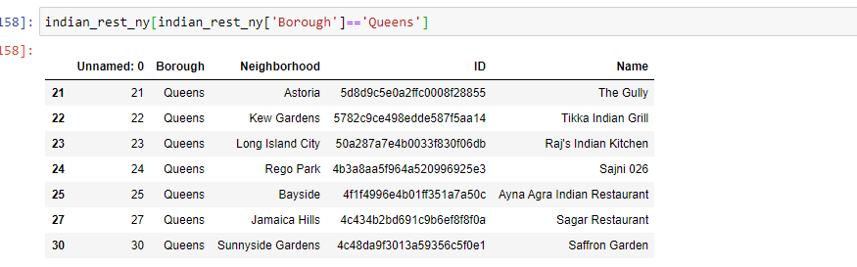
Number of Indian Restaurants in Queens Borough
Using Foursquare API call we can find out total number of Indian restaurants in Queens borough as well as we can extract a list of the same
From the graph above we came to know that there are only 7 Indian restaurants in Queens borough

Slide 13
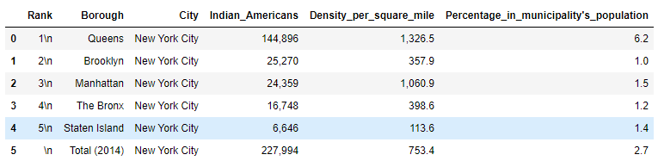
Indian Americans per borough
We need to find number of Indian Americans living in the boroughs of New York to test our hypothesis.
To find more about demography of New York boroughs I scrapped a table from the Wikipedia link already mentioned in the “Data” section.
The required table showing Indian Americans per borough has been extracted

Slide 14
Result
As it is evident from the table extracted from the census data of the New York City, there are total of 227,994 Indian Americans living in 5 boroughs of New York. Out of these more than half that is 144, 896 Indian Americans are living in Queens borough only! So, our hypothesis stood the test of data.
By analyzing the above data it was evident that we end up with rather smaller dataset with only 31 Indian Restaurant from Foursqure. So, instead of going for K means or any other clustering approach I decided to go with traditional approach of manual data crunching.

Slide 15
Discussion and Limitation
This dataset only include Indian Americans meaning people of Indian Origin who are already citizens of USA.
There is no proper data available of Indian professionals living in and around Queens borough on H1B visa and on Permanent Residence status, so they are not included in this dataset.
if included it will only increase the number of people living in Queens borough who are financially well equipped to be our potential customers.
The level of detail of this analysis is at Borough level, to find the exact location further drill down approach is required.

Slide 16
Result / Conclusion
The crux of the report is, based on data available on Foursquare there are only 7 Indian restaurants catering the needs of 144, 896 people of Queens borough, effectively meaning there is only one Indian Restaurant option available to approximately 21000 Indian Americans.
The JFK Airport which is used frequently by almost all Indian Americans living in New York area to travel to India and back, is added benefit to the location.
Also as we have already examined out of seven restaurants situated in Queens, none of them is rated highest or liked by the customers, meaning there is huge potential and virtually unexplored market for Indian cuisine restaurants in Queens borough, New York.

